Slide 1
Predicting Medicare Provider Future Expense Probability Score, Factors, and Fraud Detection
An Analysis of Medicare Provider, IRS Tax Data, and EPA Data
Presented By: Zoe Zhou, Steve Barry, and Bharat Khatri
06/04/2019

Slide 2
Agenda
Problem Statement
Datasets Used
Machine Learning Unsupervised
Machine Learning Supervised
Cloud Infrastructure
Engineering and Exploration
Future Work/Improvements

Slide 3
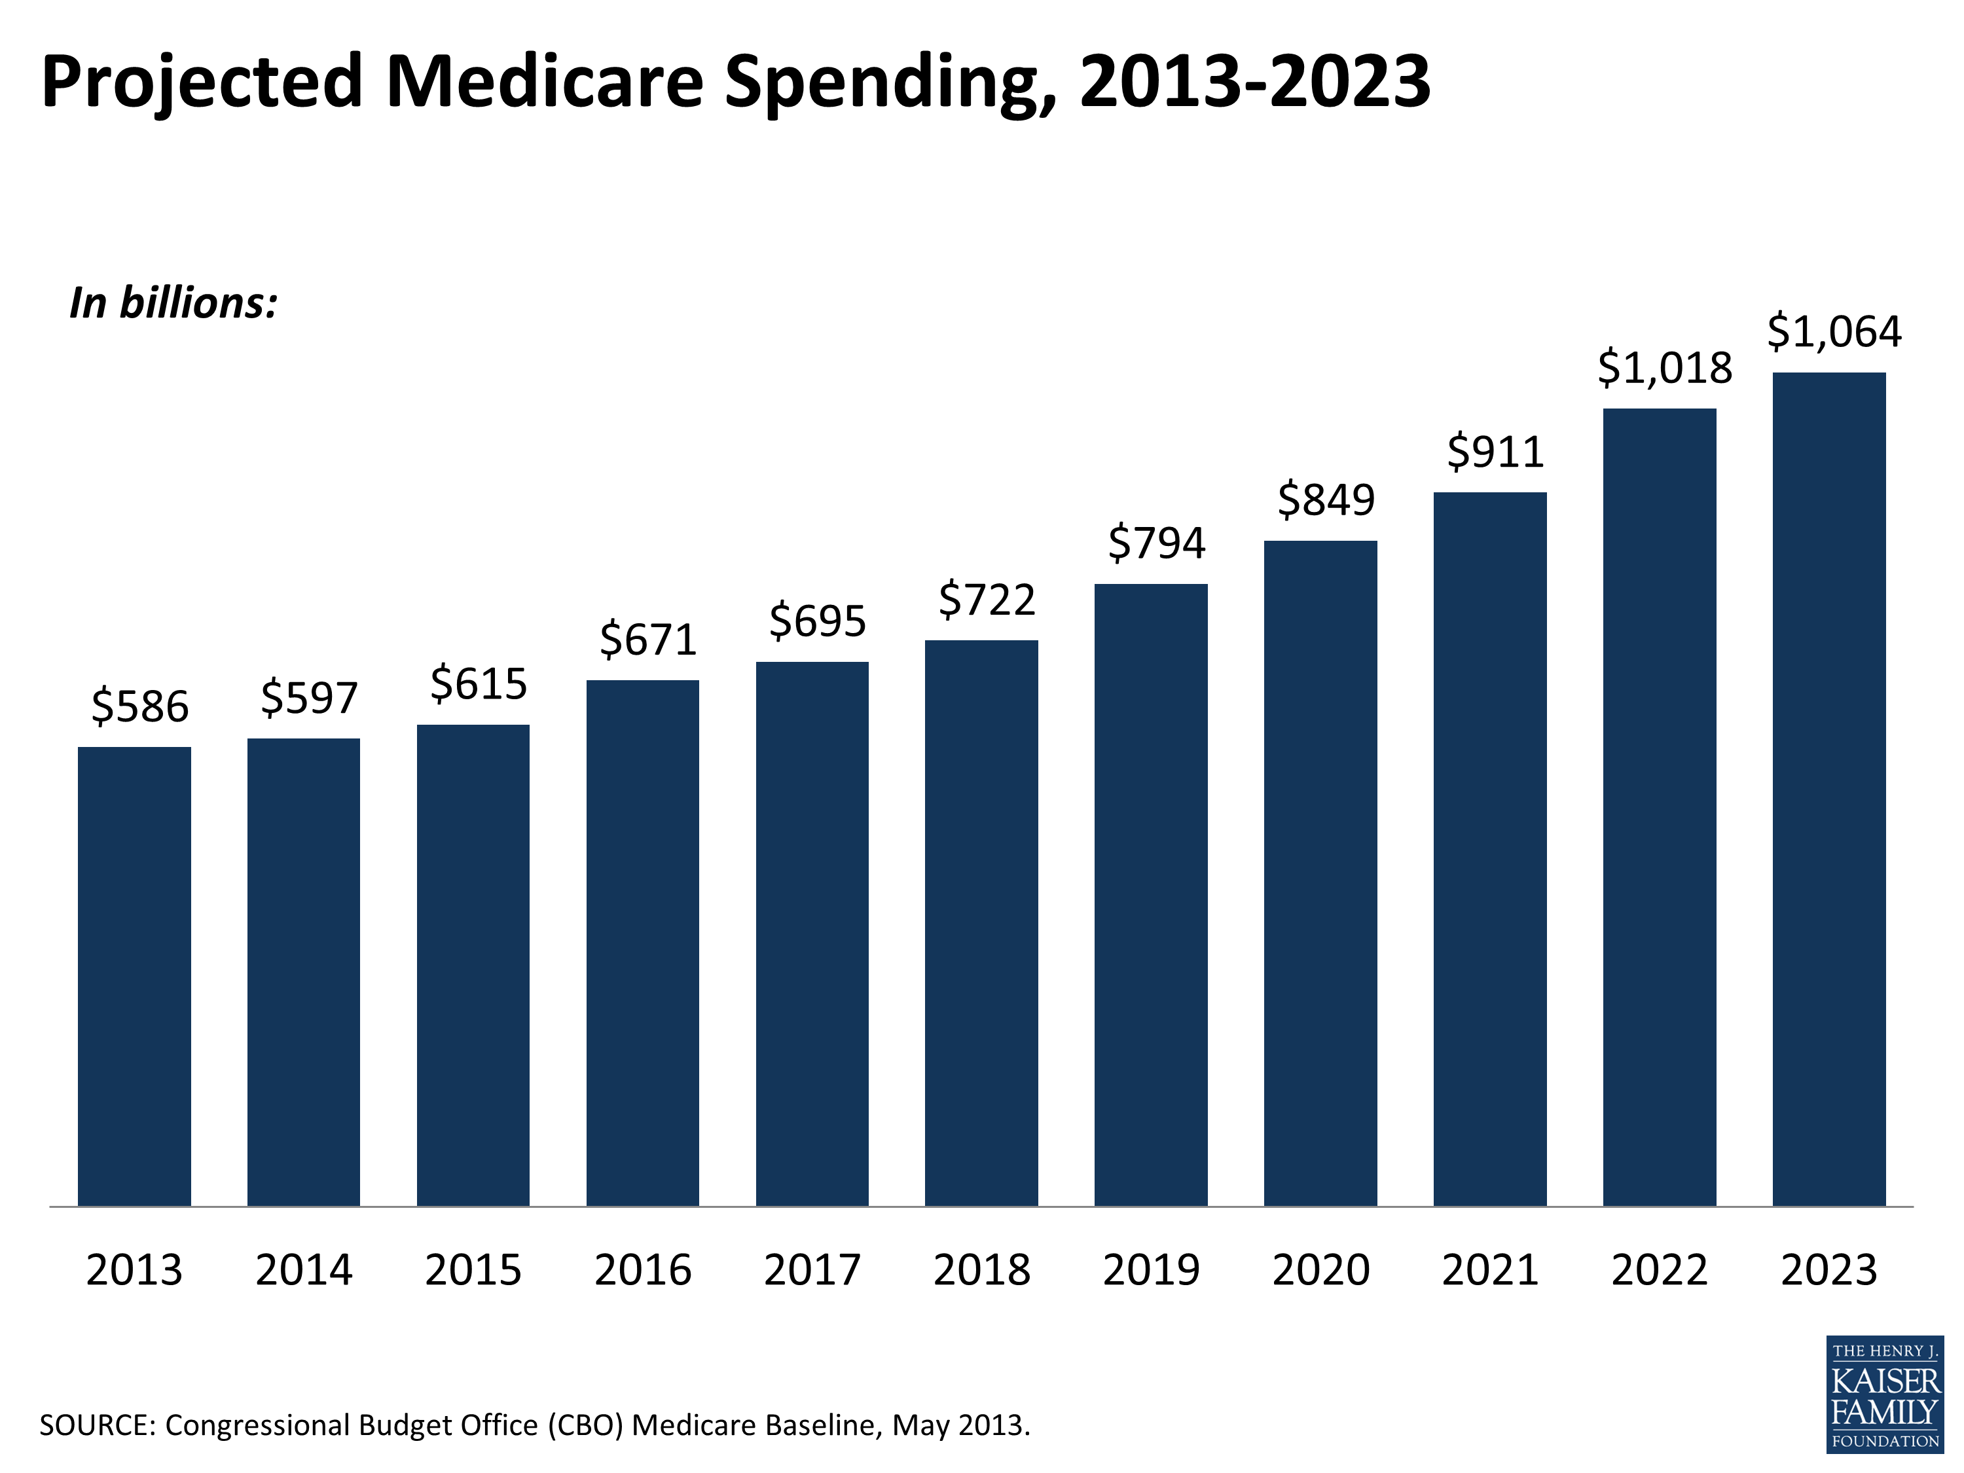
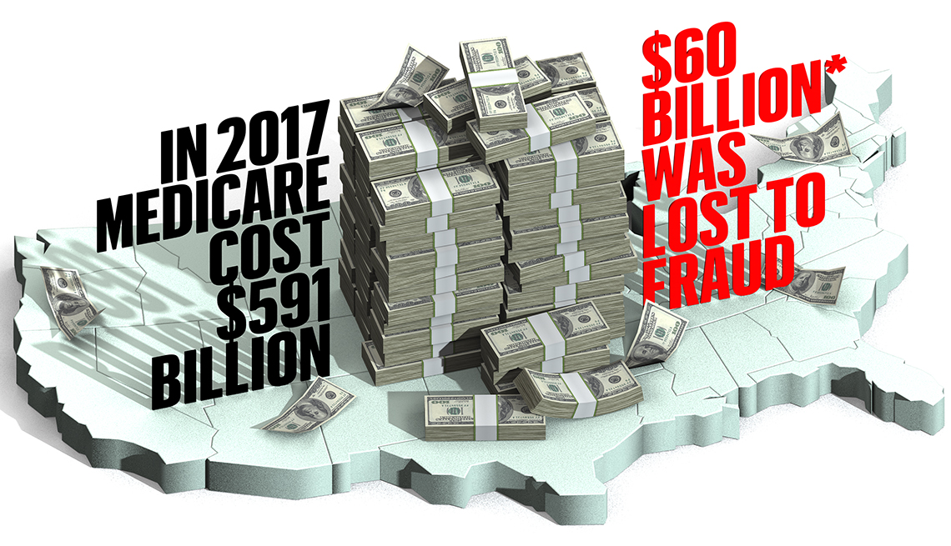
Medicare Costs are increasing and expected to continue. Additionally almost 10% of costs are related to Fraud (AARP).
Problem Statement
Datasets Used
Cloud Infrastructure
Engineering and Exploration
Machine Learning Supervised
Future Work
Machine Learning Unsupervised
https://www.kff.org/medicare/slide/projected-medicare-spending-2013-2023/
https://www.aarp.org/money/scams-fraud/info-2018/medicare-scams-fraud-identity-theft.html

Slide 4
Can we:
Problem Statement
Datasets Used
Cloud Infrastructure
Engineering and Exploration
Machine Learning Supervised
Future Work
Machine Learning Unsupervised
Build a model to predict Medicare HCC score of healthcare providers to anticipate costs? And what are the primary factors? ​
Construct an anomaly detection engine using clustering technics to identify potential fraud?

Slide 5
Data Used
Problem Statement
Datasets Used
Cloud Infrastructure
Engineering and Exploration
Machine Learning Supervised
Future Work
Machine Learning Unsupervised
Original Sources: Medicare, IRS, EPA, and US Zip Code Data
Sampled from Kaggle, IRS, and simplemaps.com
https://www.kaggle.com/cms/medicare-physician-other-supplier-npi-aggregates
https://www.irs.gov/statistics/soi-tax-stats-individual-income-tax-statistics-zip-code-data-soi
https://www.kaggle.com/epa/hazardous-air-pollutants
https://www.kaggle.com/epa/carbon-monoxide
https://simplemaps.com/data/us-zips
Medicare Data 2012-2016 (6,747,040 x 67-70 x 5)
Annual Information on all Medicare Healthcare Providers
Including HCC score (prediction of future Medicare billing)
5 independent files
IRS Tax Data 2012-2016 (846,860 x 77 x 5)
Annual aggregate tax return information by zip code district
5 independent files
EPA Carbon Monoxide (CO) Levels Data 2001-2017 (8,064,820 x 31)
17 years of hourly (and 8 hour aggregated) measurement of CO by EPA sensor and US state and county code
US Zip Code Data (33,100 x 16)
US Zip Code, State, County Code, and other demographic data

Slide 6
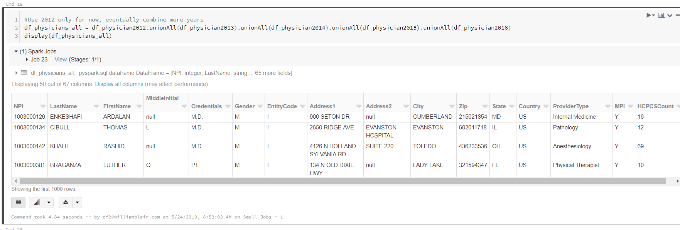
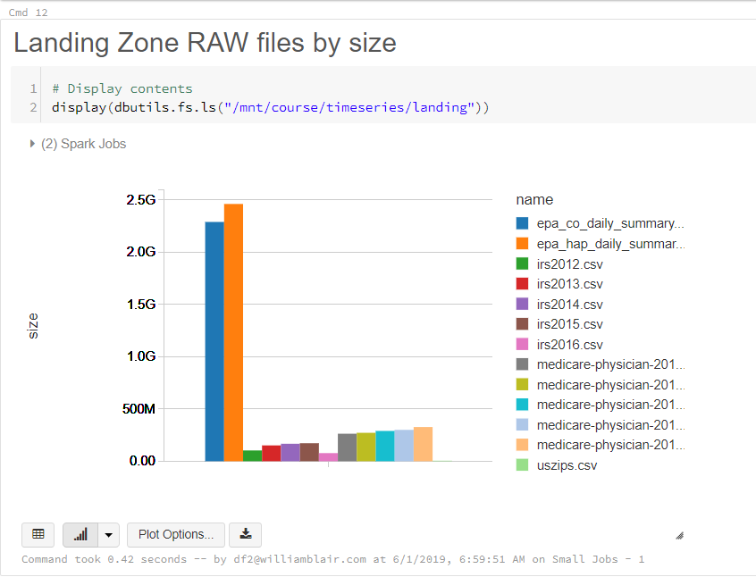
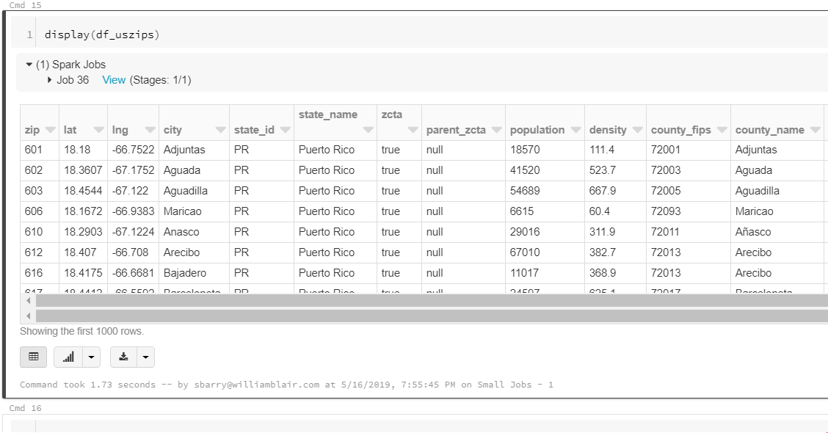
Problem Statement
Datasets Used
Cloud Infrastructure
Engineering and Exploration
Machine Learning Supervised
Future Work
Machine Learning Unsupervised
Data Used
Medicare Data
All Data
US Zip to County Code

Slide 7
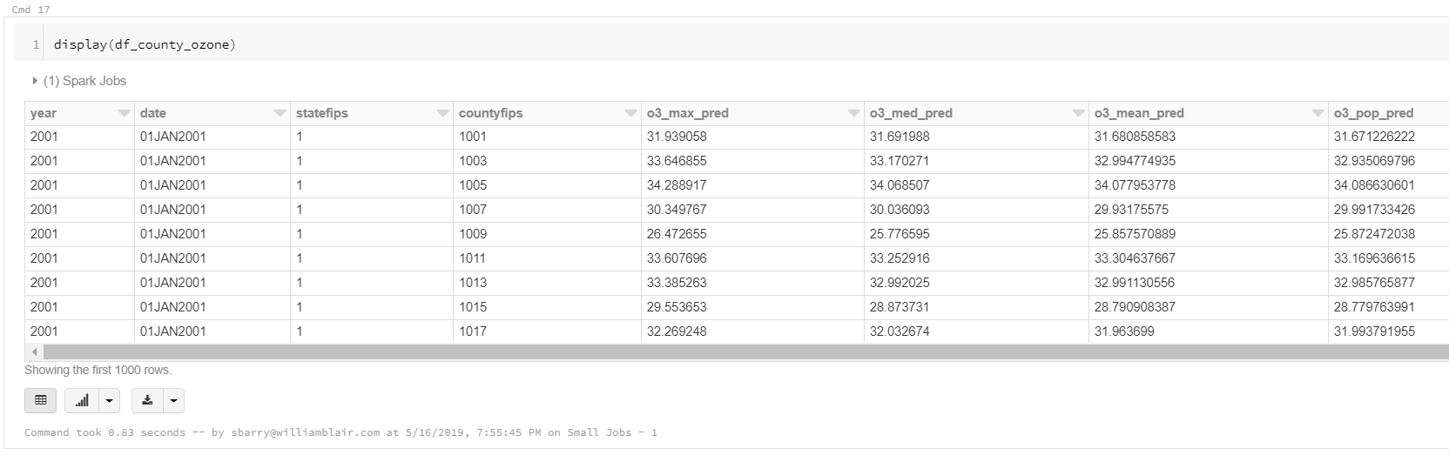
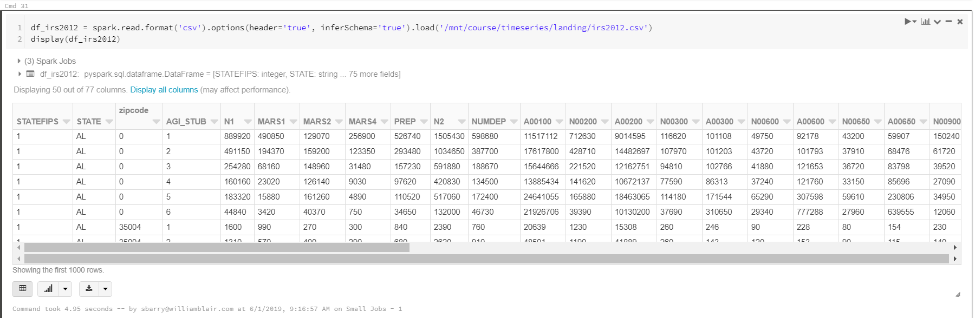
Problem Statement
Datasets Used
Cloud Infrastructure
Engineering and Exploration
Machine Learning Supervised
Future Work
Machine Learning Unsupervised
Data Used
EPA Data
All Data
IRS Aggregate Tax Data

Slide 8













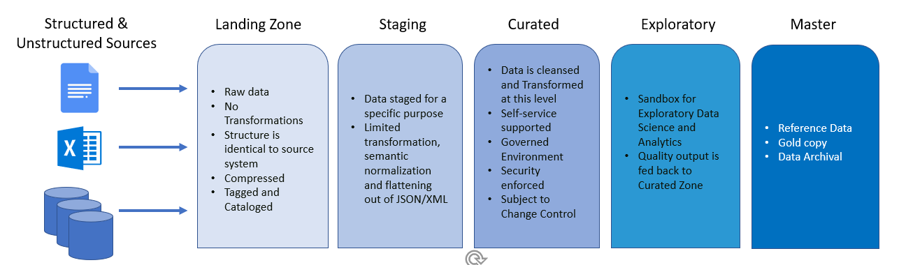
Problem Statement
Datasets Used
Cloud Infrastructure
Engineering and Exploration
Machine Learning Supervised
Future Work
Machine Learning Unsupervised
Solution Architecture:
Proposed System Map
Active Directory
Integrated AD Security (Application, Data, and Portal Security via RBAC)
Medicare Provider
Data
In Place
Data Catalog
Power BI
Data Factory
Blob Storage
IRS Tax Data
End User
Tableau
EPA Pollution Data
ADLS gen2*
Azure Data Warehouse
API
US Zip Codes to County
DataBricks (aka -Spark)
Not Yet Built
Data Lake Zoning Strategy
Landing Zone/RAW Zone
Staging Zone
Curated Zone
Exploratory Zone
Master Zone

Slide 9
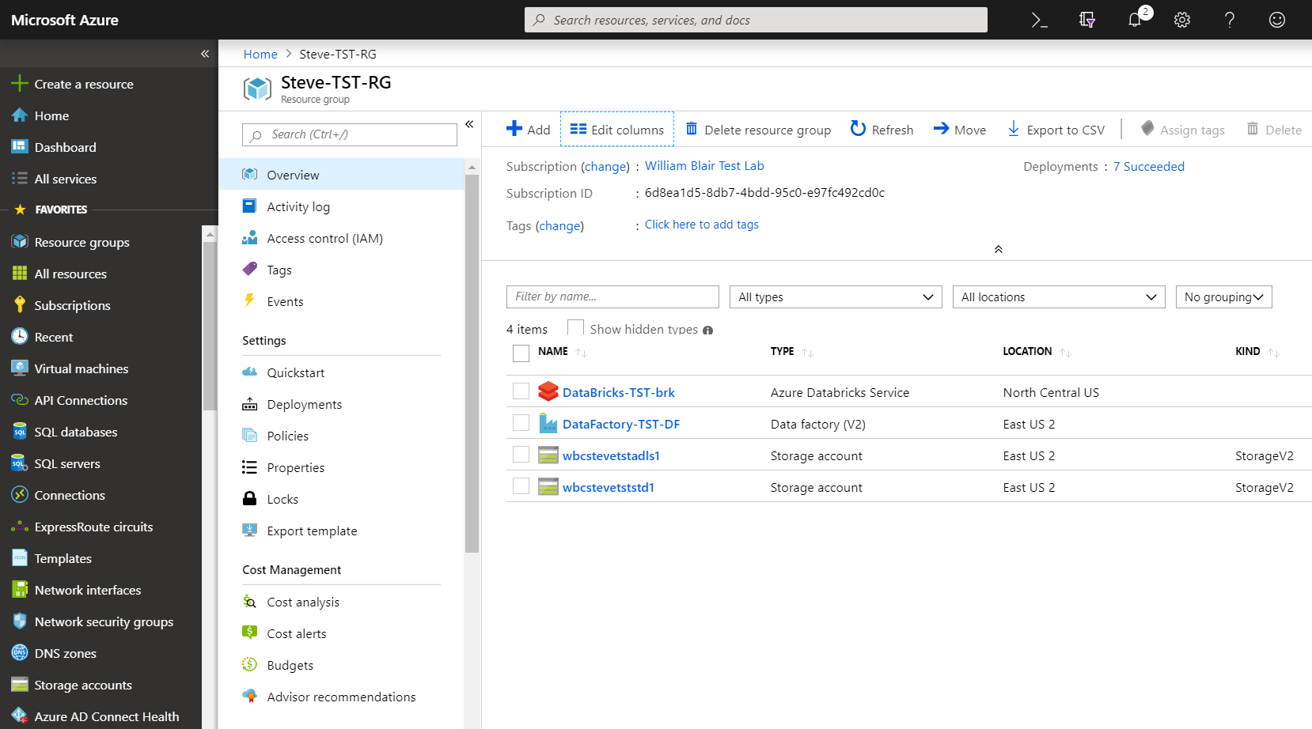
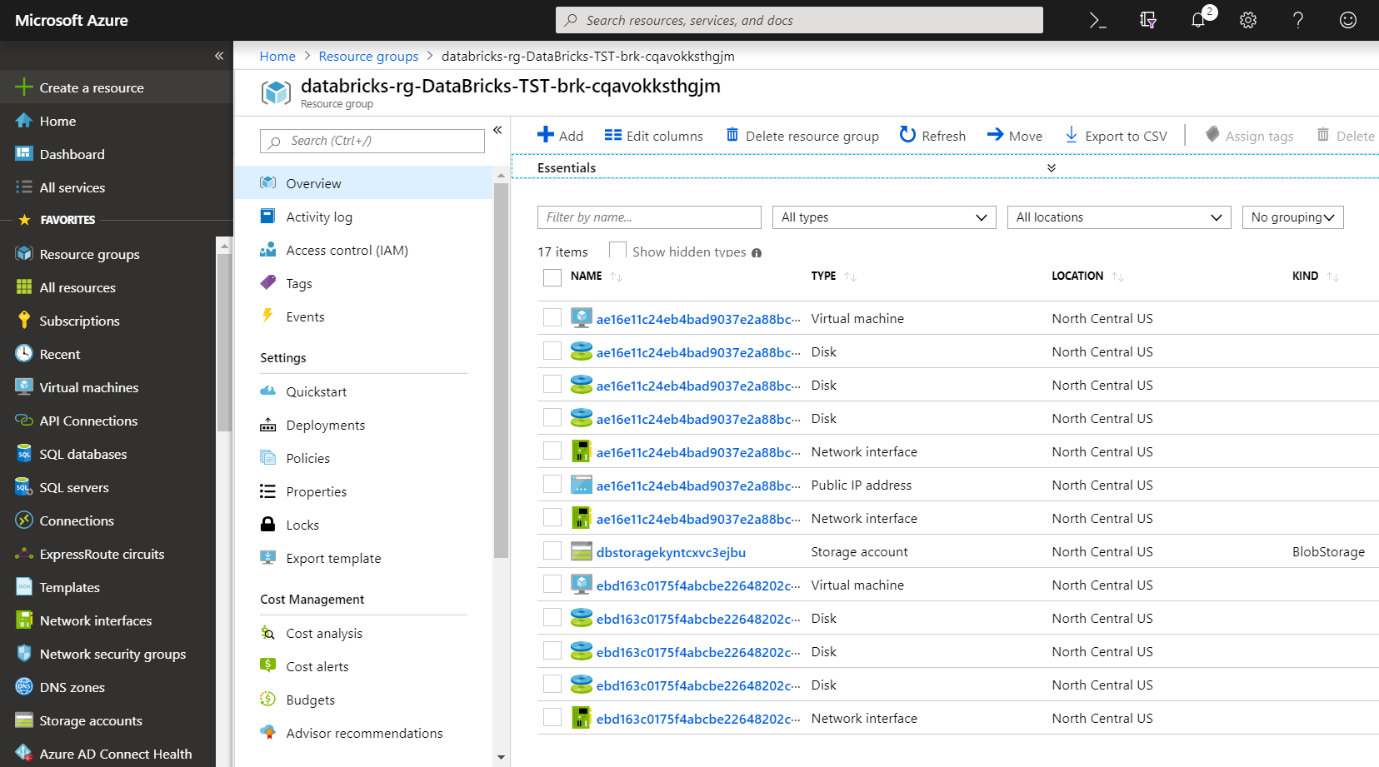
Problem Statement
Datasets Used
Cloud Infrastructure
Engineering and Exploration
Machine Learning Supervised
Future Work
Machine Learning Unsupervised
Azure Portal:
Cloud Infrastructure Objects
Databricks Service, Data Lake, and Data Factory
Databricks/Spark Cluster VMs

Slide 10
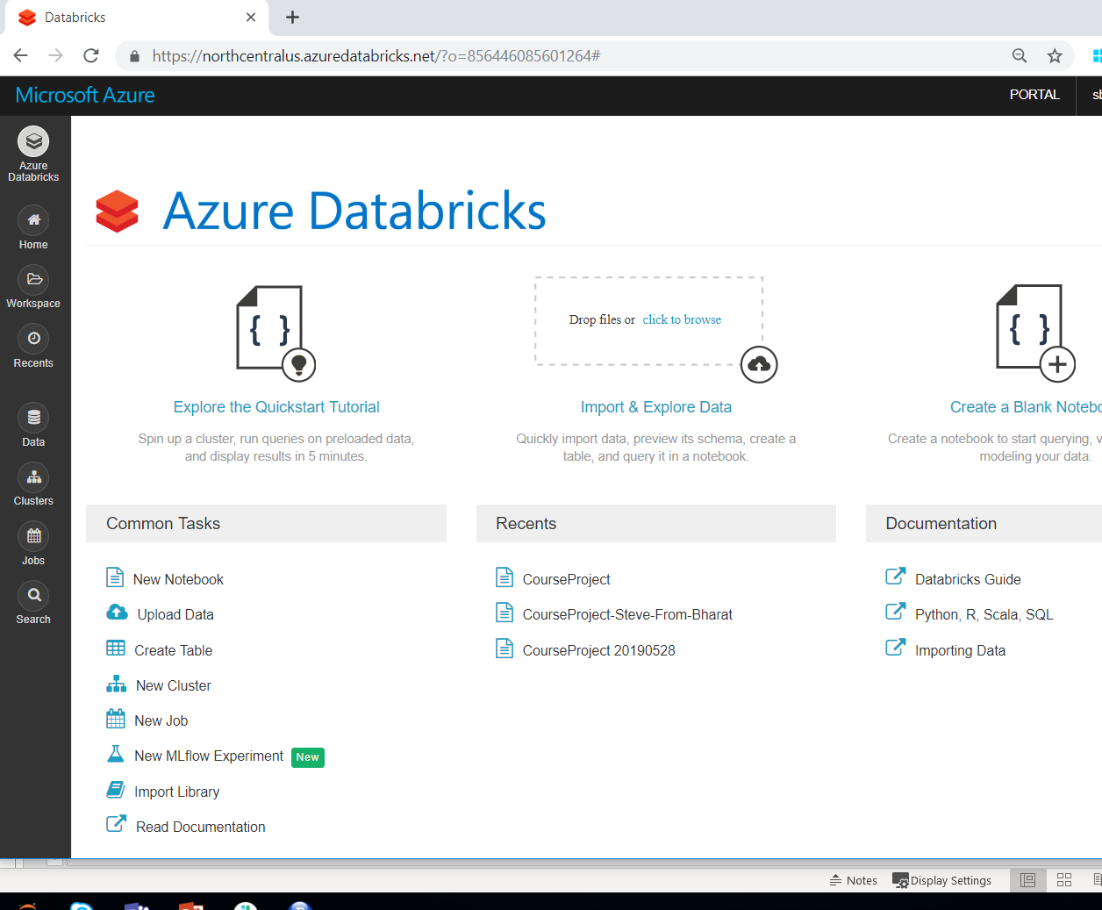
Problem Statement
Datasets Used
Cloud Infrastructure
Engineering and Exploration
Machine Learning Supervised
Future Work
Machine Learning Unsupervised
Azure Databricks Environment
Navigation Bar
Home - Navigation
Workspaces – Notebook Storage
Recents – Recent Notebooks
Data – Hive
Cluster – Spark Compute
Jobs – Operational Jobs/API
Search – Search

Slide 11
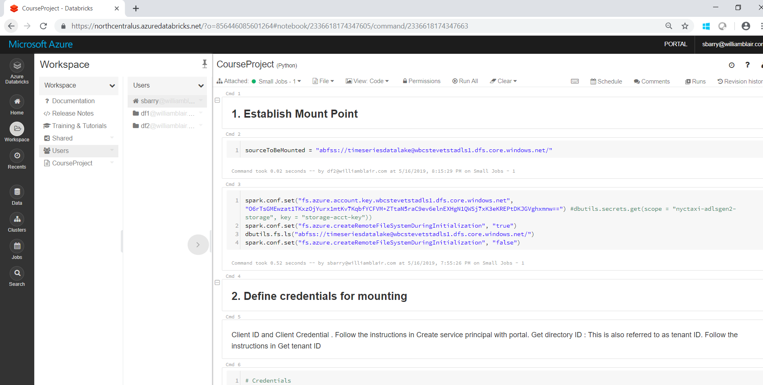
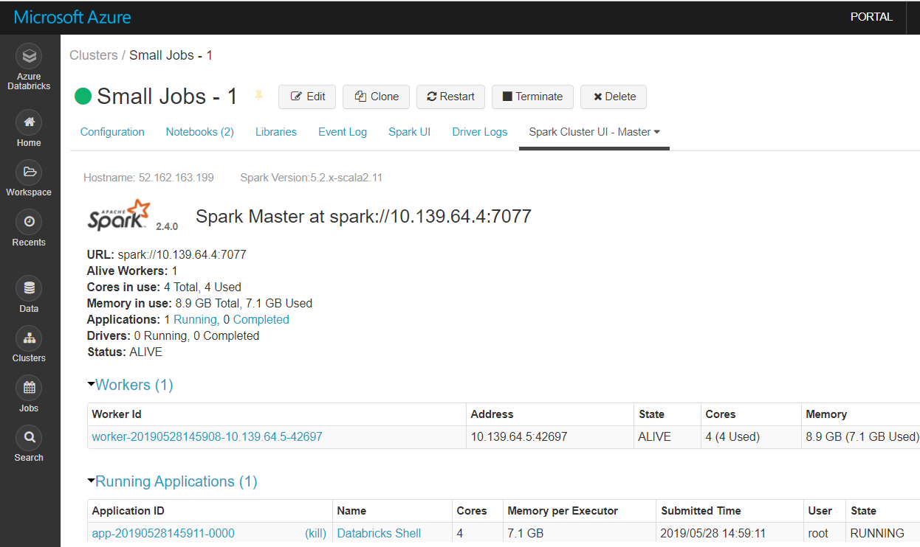
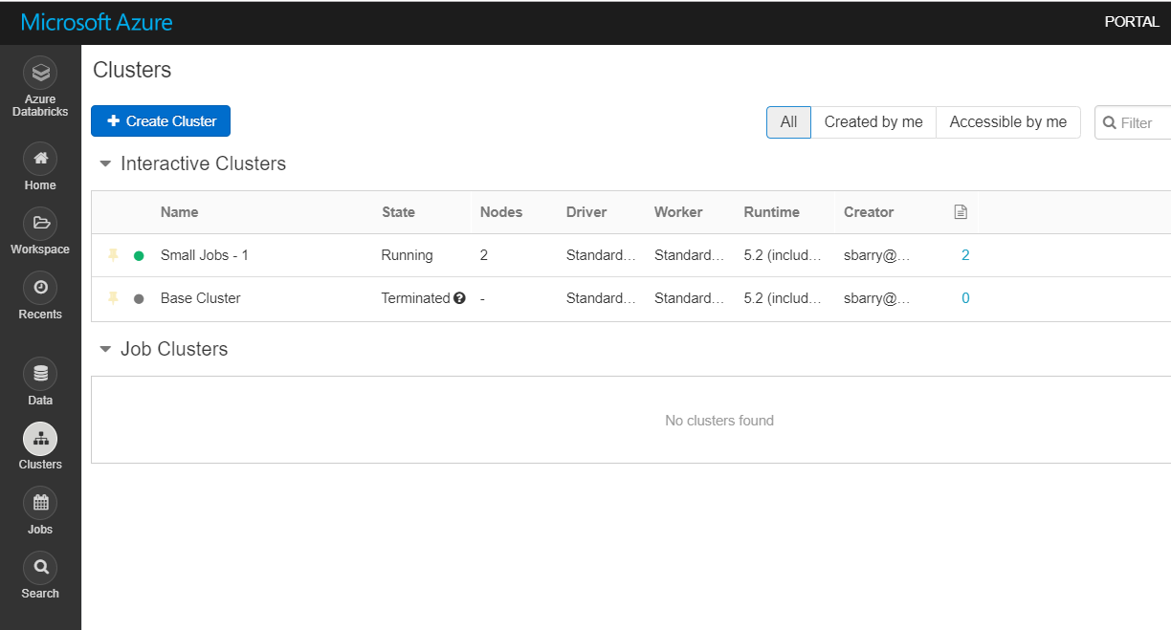
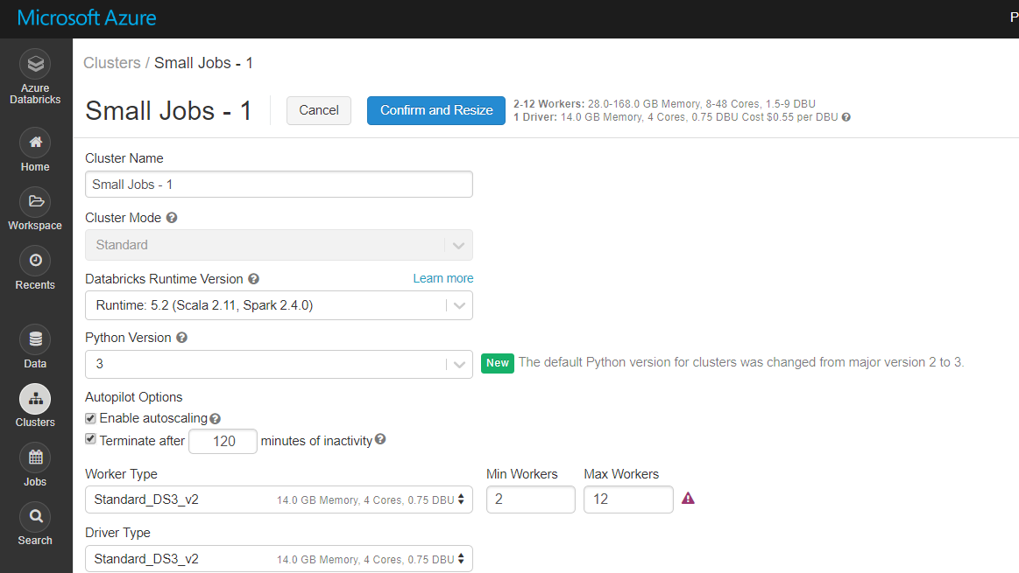
Problem Statement
Datasets Used
Cloud Infrastructure
Engineering and Exploration
Machine Learning Supervised
Future Work
Machine Learning Unsupervised
Workspaces (Notebooks)
Clusters (Spark Compute Cluster)

Slide 12
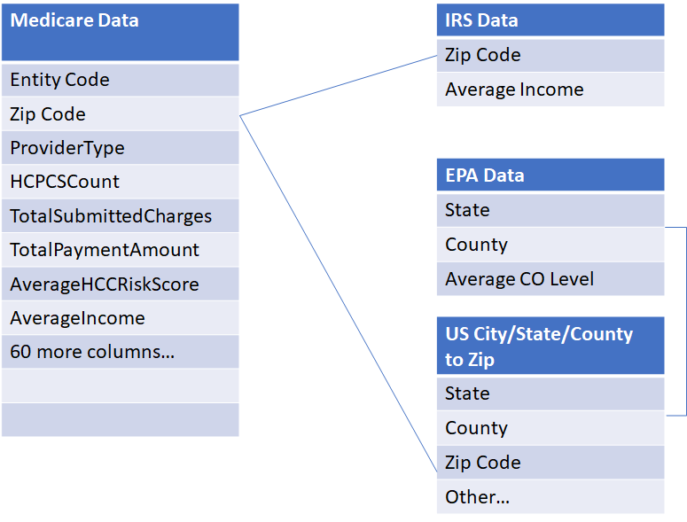
Final Dataset
Problem Statement
Datasets Used
Cloud Infrastructure
Engineering and Exploration
Machine Learning Supervised
Future Work
Machine Learning Unsupervised
Medicare Data:
By Provider Zip Code, Year
IRS Data:
By Zip Code, Year
EPA CO Data:
By Zip Code, Year
US City to Zip:
State
County Code
Zip Code

Slide 13
Data Engineering Highlights and Challenges
Problem Statement
Datasets Used
Cloud Infrastructure
Engineering and Exploration
Machine Learning Supervised
Future Work
Machine Learning Unsupervised
Medicare
5 datasets needed to be merged
Different columns between datasets
Converted HCC Score from continuous to categorical
IRS
5 datasets needed to be merged
EPA
Group by year and compute yearly average
Converted County Code and merged with State to merge with Medicare/IRS datasets
USZIPs
Converted County Code and merged with State to merge to merge with Medicare/IRS datasets
Global Dataset
One Hot Encoding of categorical variables
UDF to identify missing values and eliminate columns
Needed to upgrade cluster to run on the large merged dataset

Slide 14
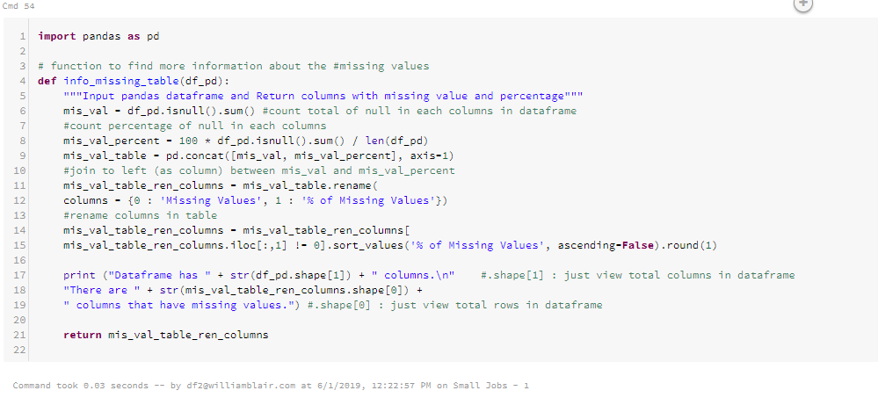
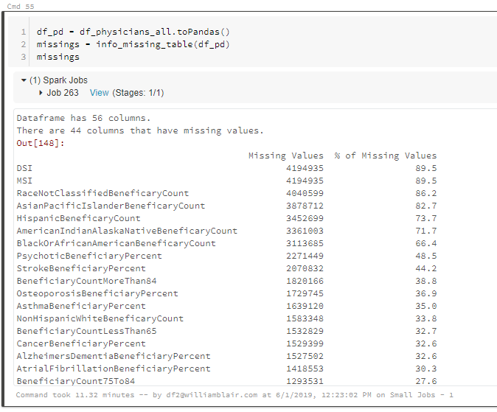
Problem Statement
Datasets Used
Cloud Infrastructure
Engineering and Exploration
Machine Learning Supervised
Future Work
Machine Learning Unsupervised
User Defined Function to quantify missing values

Slide 15
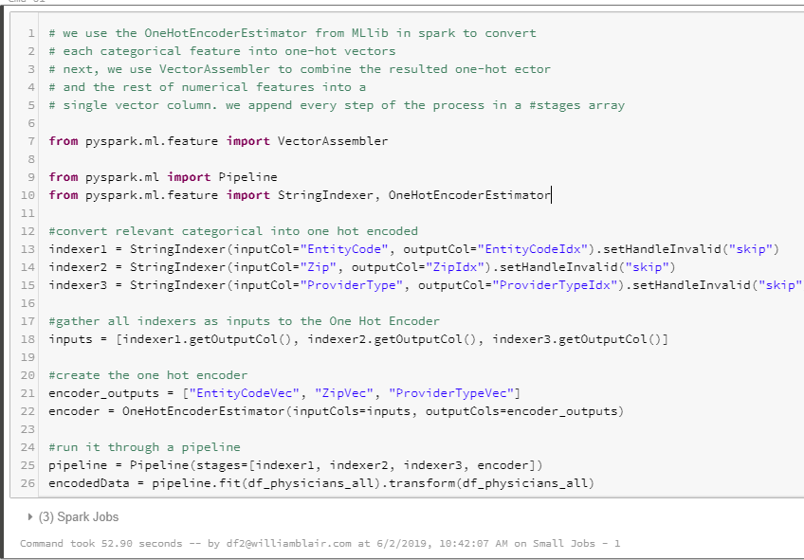
Problem Statement
Datasets Used
Cloud Infrastructure
Engineering and Exploration
Machine Learning Supervised
Future Work
Machine Learning Unsupervised
One Hot Encoding for Categorical Variables

Slide 16
Unsupervised Learning
Problem Statement
Datasets Used
Cloud Infrastructure
Engineering and Exploration
Machine Learning Supervised
Future Work
Machine Learning Unsupervised
Can we construct an anomaly detection engine using clustering technics to identify potential fraud?
Proposed Solution: K-Means Clustering to identify outliers and outlier groups

Slide 17
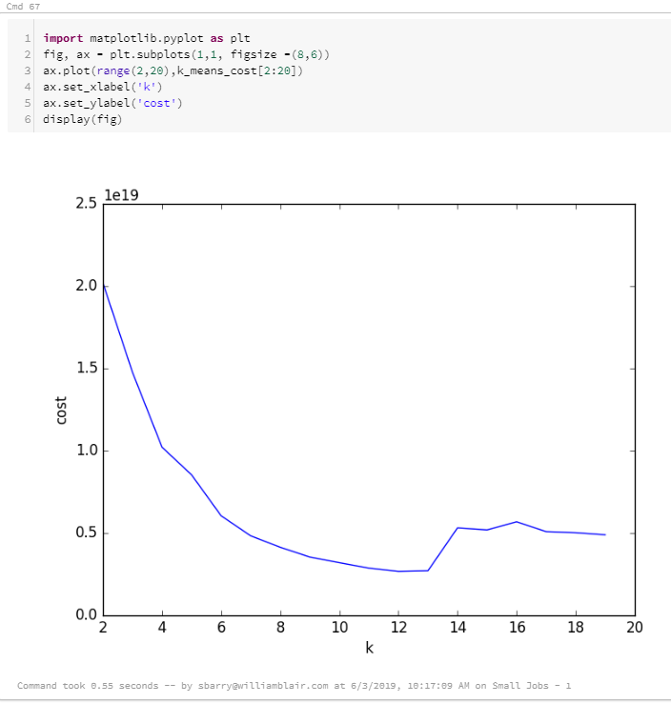
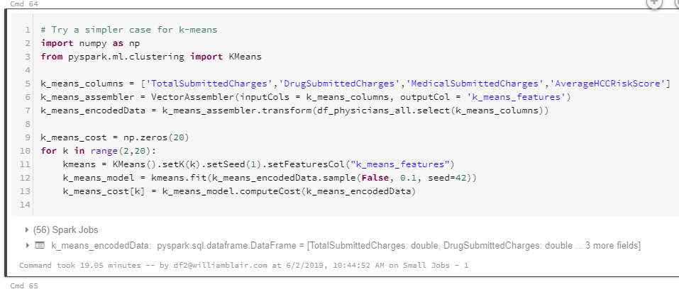
Parameter and Hyperparameter Selection
Problem Statement
Datasets Used
Cloud Infrastructure
Engineering and Exploration
Machine Learning Supervised
Future Work
Machine Learning Unsupervised
Plot of Cost Function
Optimize k value for K-Means Clustering cost function

Slide 18
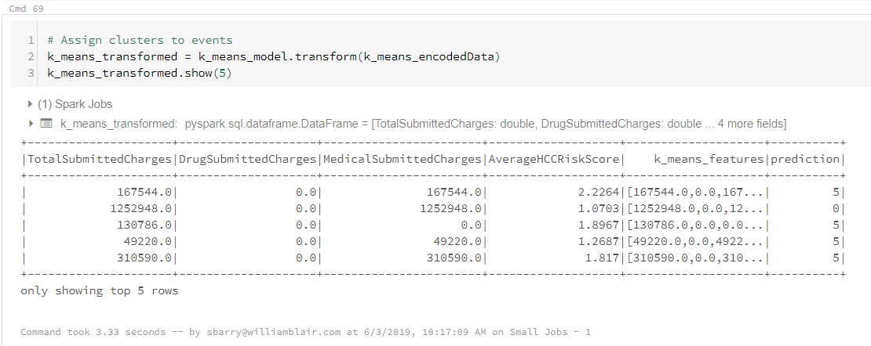
Unsupervised Learning
Problem Statement
Datasets Used
Cloud Infrastructure
Engineering and Exploration
Machine Learning Supervised
Future Work
Machine Learning Unsupervised
Looking at the 1st few Results

Slide 19
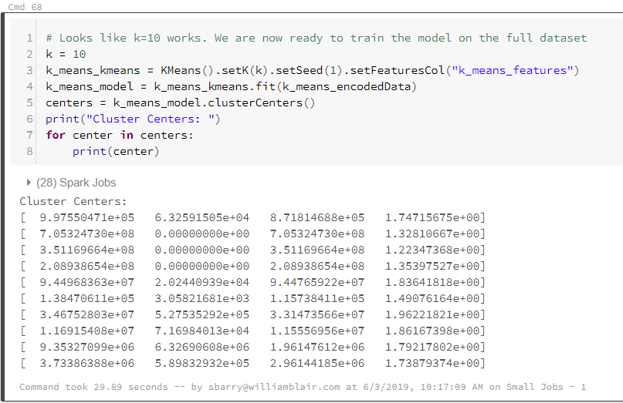
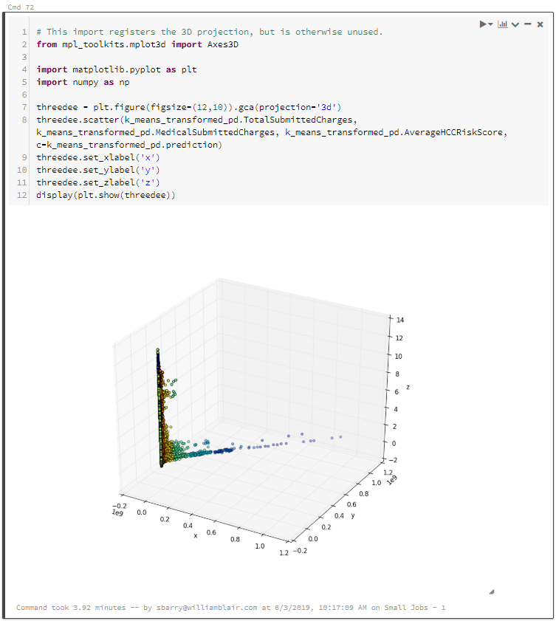
K-Means Cluster Results, Centers, and Plot
Problem Statement
Datasets Used
Cloud Infrastructure
Engineering and Exploration
Machine Learning Supervised
Future Work
Machine Learning Unsupervised
K-means cluster with k = 10 and identified Centers
Plot of 10 Identified Clusters
Outliers
Plot of K-Means in pandas

Slide 20
Supervised Learning
Problem Statement
Datasets Used
Cloud Infrastructure
Engineering and Exploration
Machine Learning Supervised
Future Work
Machine Learning Unsupervised
Can we build a model to predict Medicare HCC score range of healthcare providers to anticipate costs? And what are the primary factors? ​
Proposed Models:
Logistic Regression
Random Forest

Slide 21
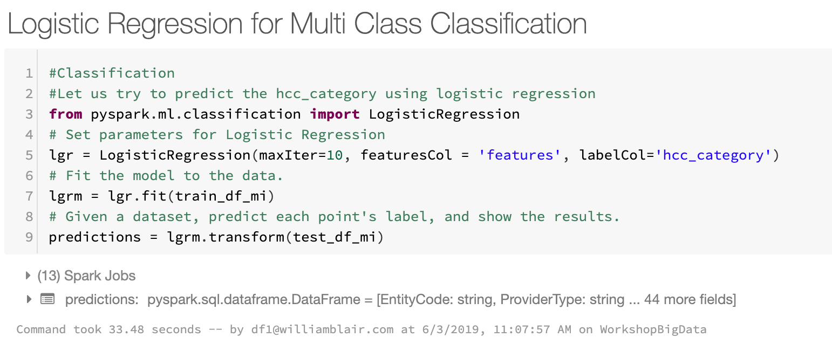
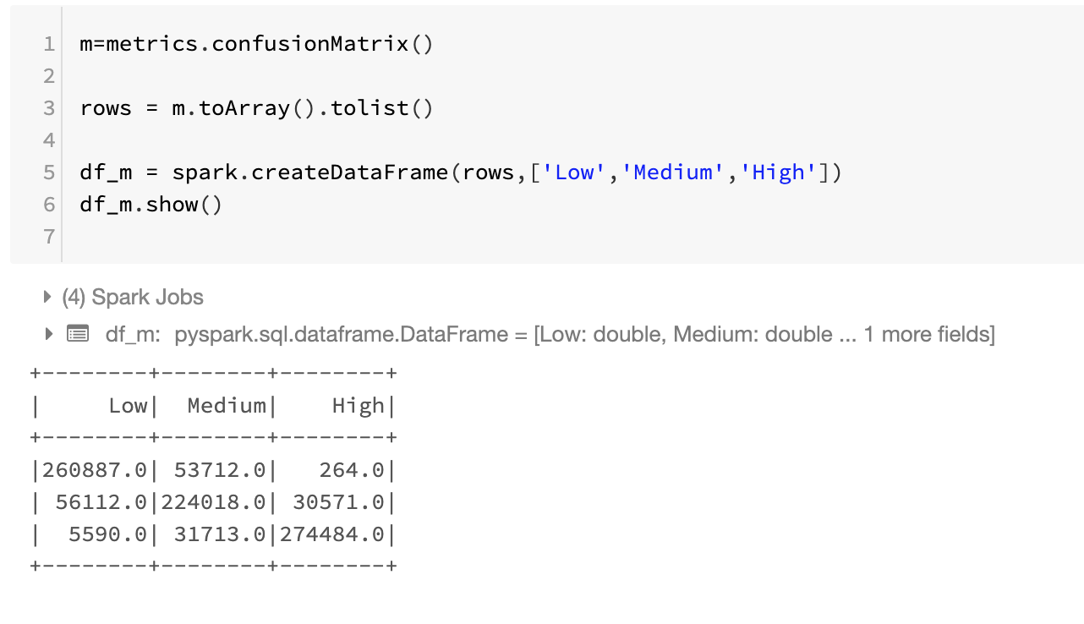
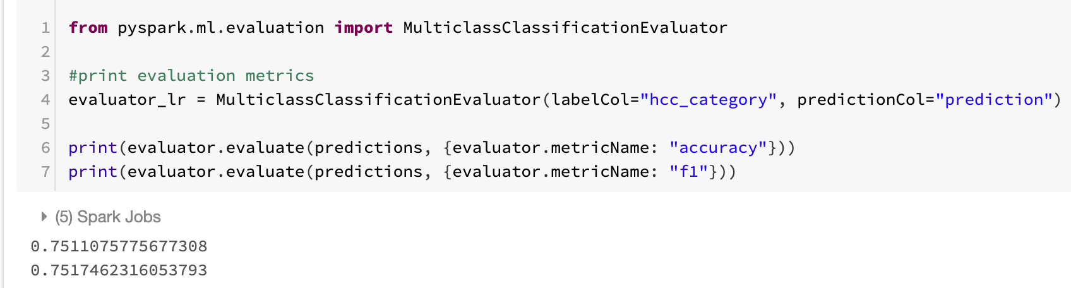
Problem Statement
Datasets Used
Cloud Infrastructure
Engineering and Exploration
Machine Learning Supervised
Future Work
Machine Learning Unsupervised
Model – Logistic Regression
Fitting the model
Confusion Matrices
Model Accuracy (with 10, 10)

Slide 22
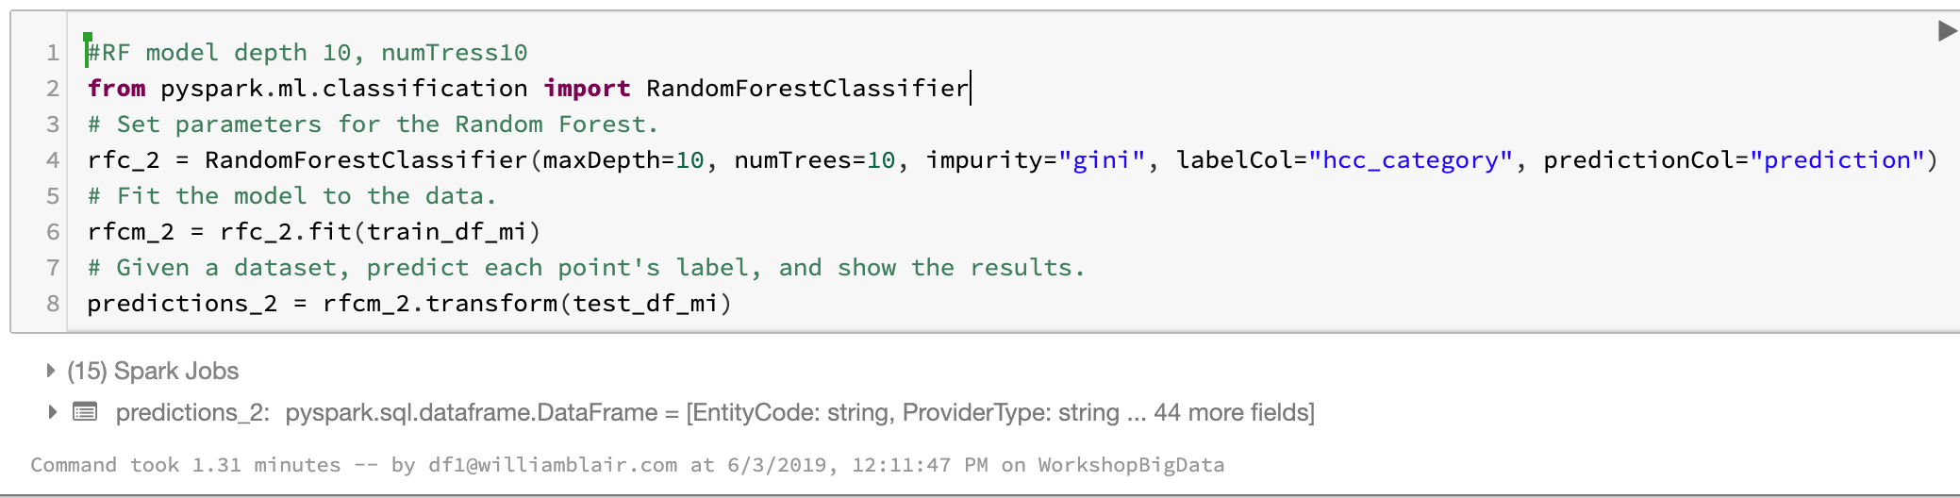
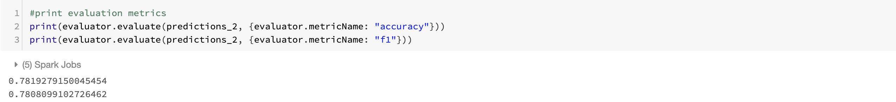
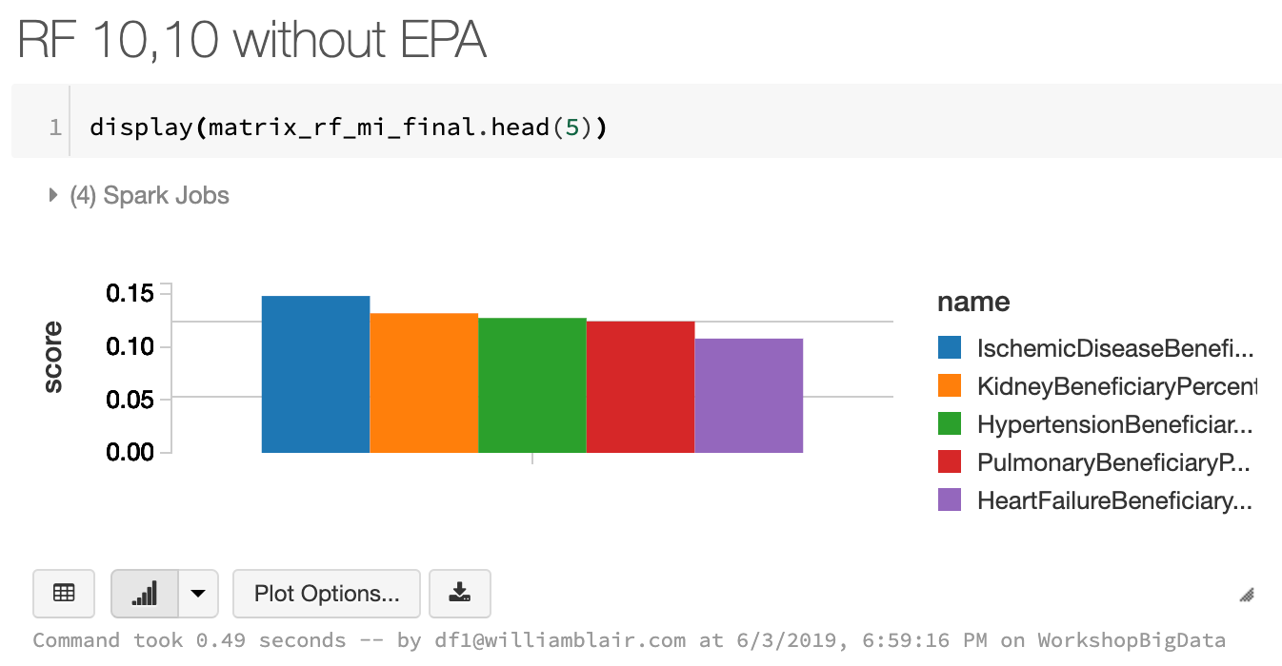
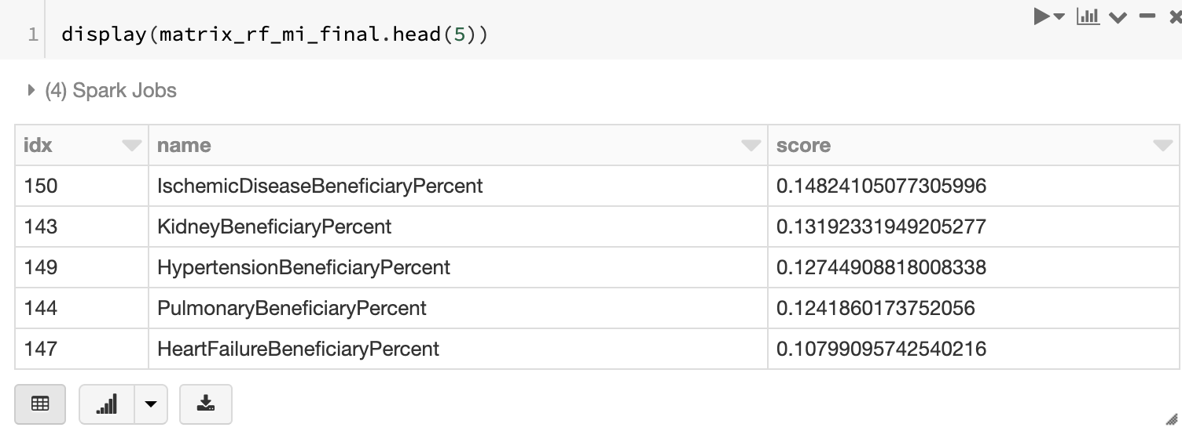
Problem Statement
Datasets Used
Cloud Infrastructure
Engineering and Exploration
Machine Learning Supervised
Future Work
Machine Learning Unsupervised
Model – Random Forest without EPA (10,10)
Fitting the model (with 10, 10)
Model Accuracy (with 10, 10)
Plot of significant Features
Output of Significant Features

Slide 23
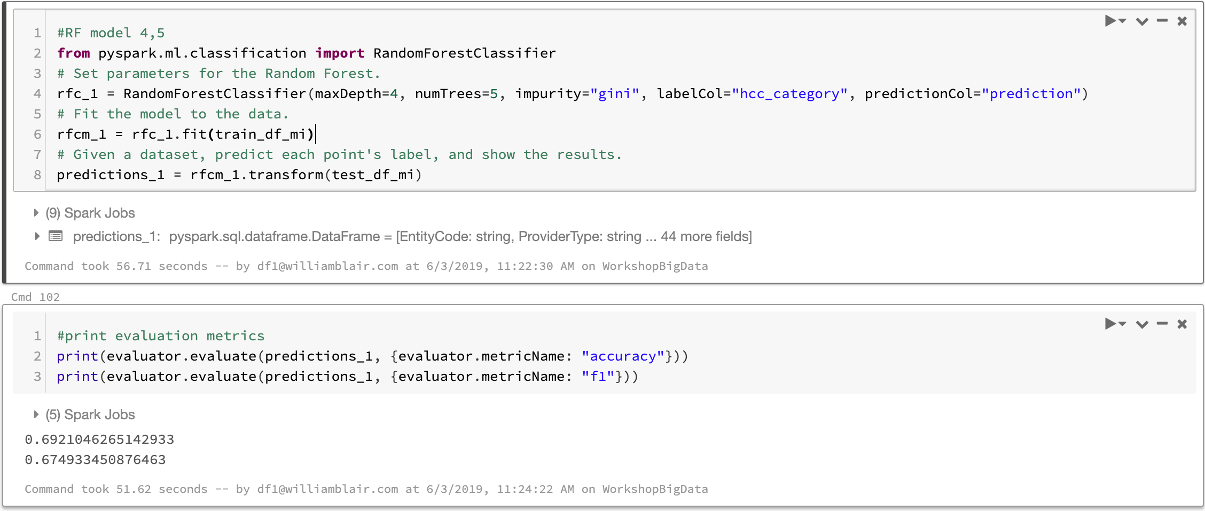
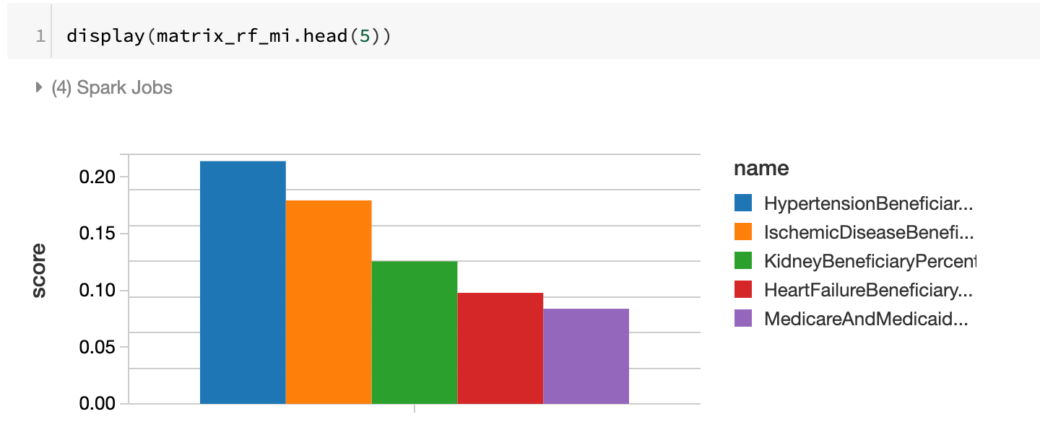
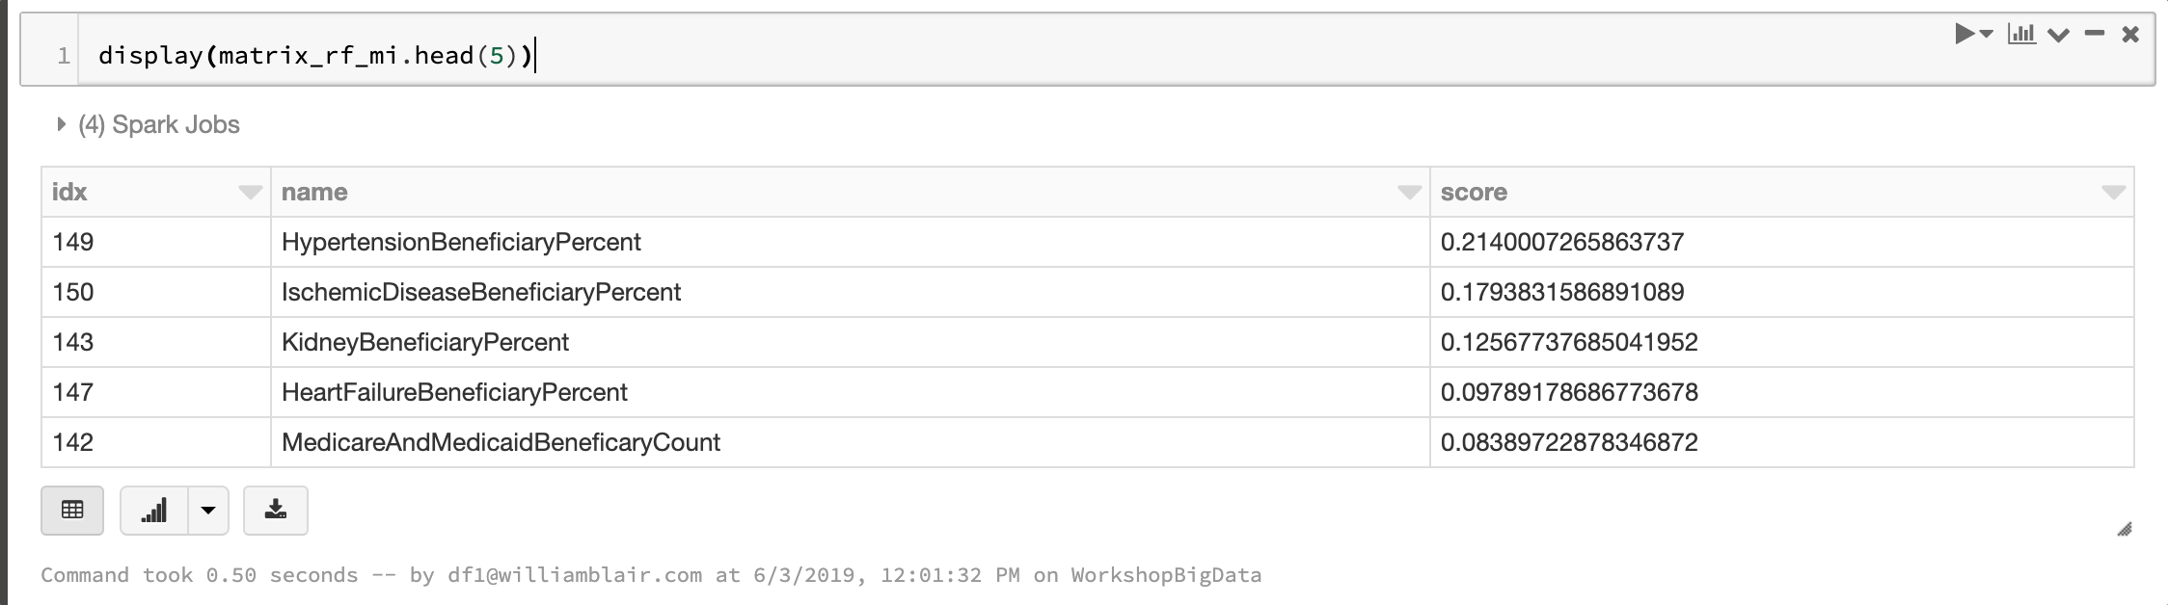
Problem Statement
Datasets Used
Cloud Infrastructure
Engineering and Exploration
Machine Learning Supervised
Future Work
Machine Learning Unsupervised
Model – Random Forest without EPA (4,5)
Fitting the model (with 4, 5)
Model Accuracy (with 4, 5)
Plot of significant Features
Output of Significant Features

Slide 24
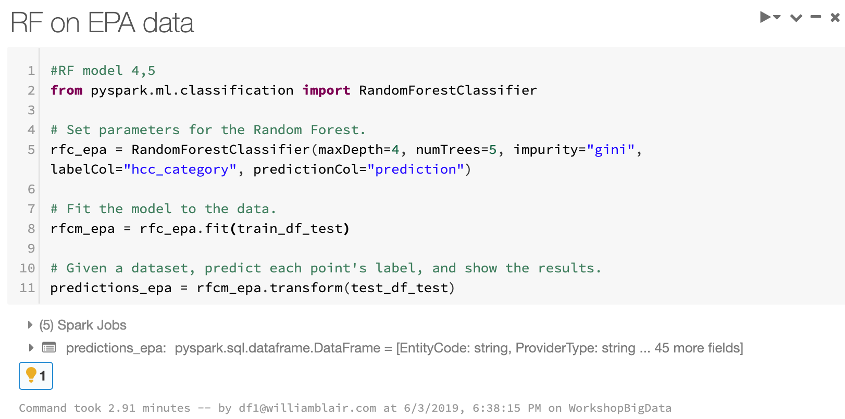
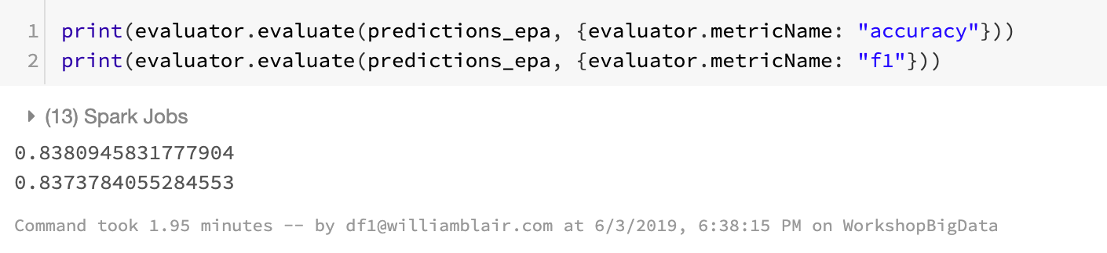
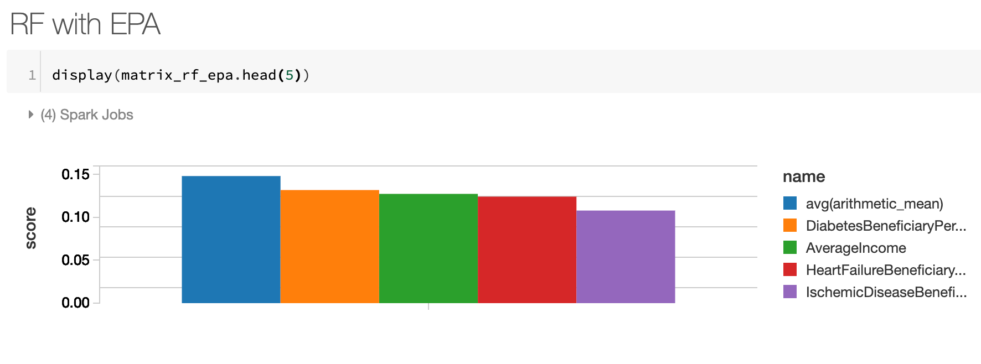
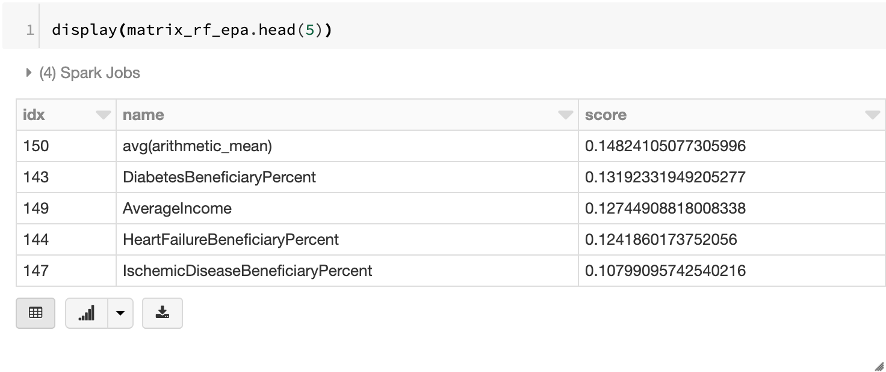
Problem Statement
Datasets Used
Cloud Infrastructure
Engineering and Exploration
Machine Learning Supervised
Future Work
Machine Learning Unsupervised
Model – Random Forest including EPA (4,5)
Fitting the model (with 4, 5)
Model Accuracy (with 4, 5)
Plot of significant Features
Output of Significant Features

Slide 25
Problem Statement
Datasets Used
Cloud Infrastructure
Engineering and Exploration
Machine Learning Supervised
Future Work
Machine Learning Unsupervised
Future Work
Attempt different models such Neural Nets, XGBoost, KNN, or Hierarchical Clustering
Consider dimensionality reducing techniques for feature engineering such as PCA and TSNE
Use alternative combinations for K-Means clustering

Slide 26

Predicting Medicare Provider Future Expense Probability Score, Factors, and Fraud Detection
An Analysis of Medicare Provider, IRS Tax Data, and EPA Data
Presented By: Zoe Zhou, Steve Barry, and Bharat Khatri
06/04/2019

